Slide 1
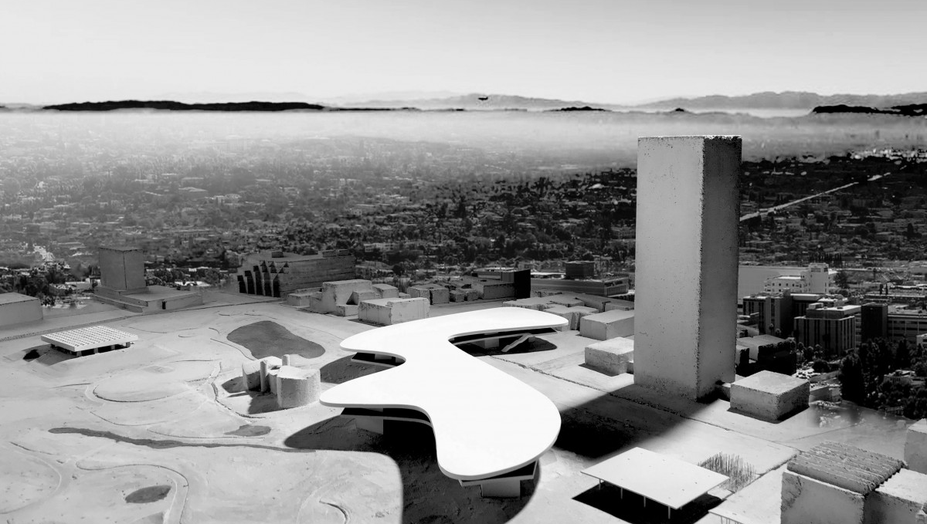
LACMA: Online Ticketing Performance Analysis
Notes: plot titles need to be changed
Nomenclature change from “Non-member” to “Guest”
LACMA

Slide 2
Agenda
1
Research Goals & Approach
2
User Journeys & Supporting Data
3
Recommendations
4
Further Evaluations
LACMA
Outlining LACMA’s Objectives
Drilling into the Pain Points
Drawing insights from Competitors
Considerations to improve Insights
Notes:
DS

Slide 3
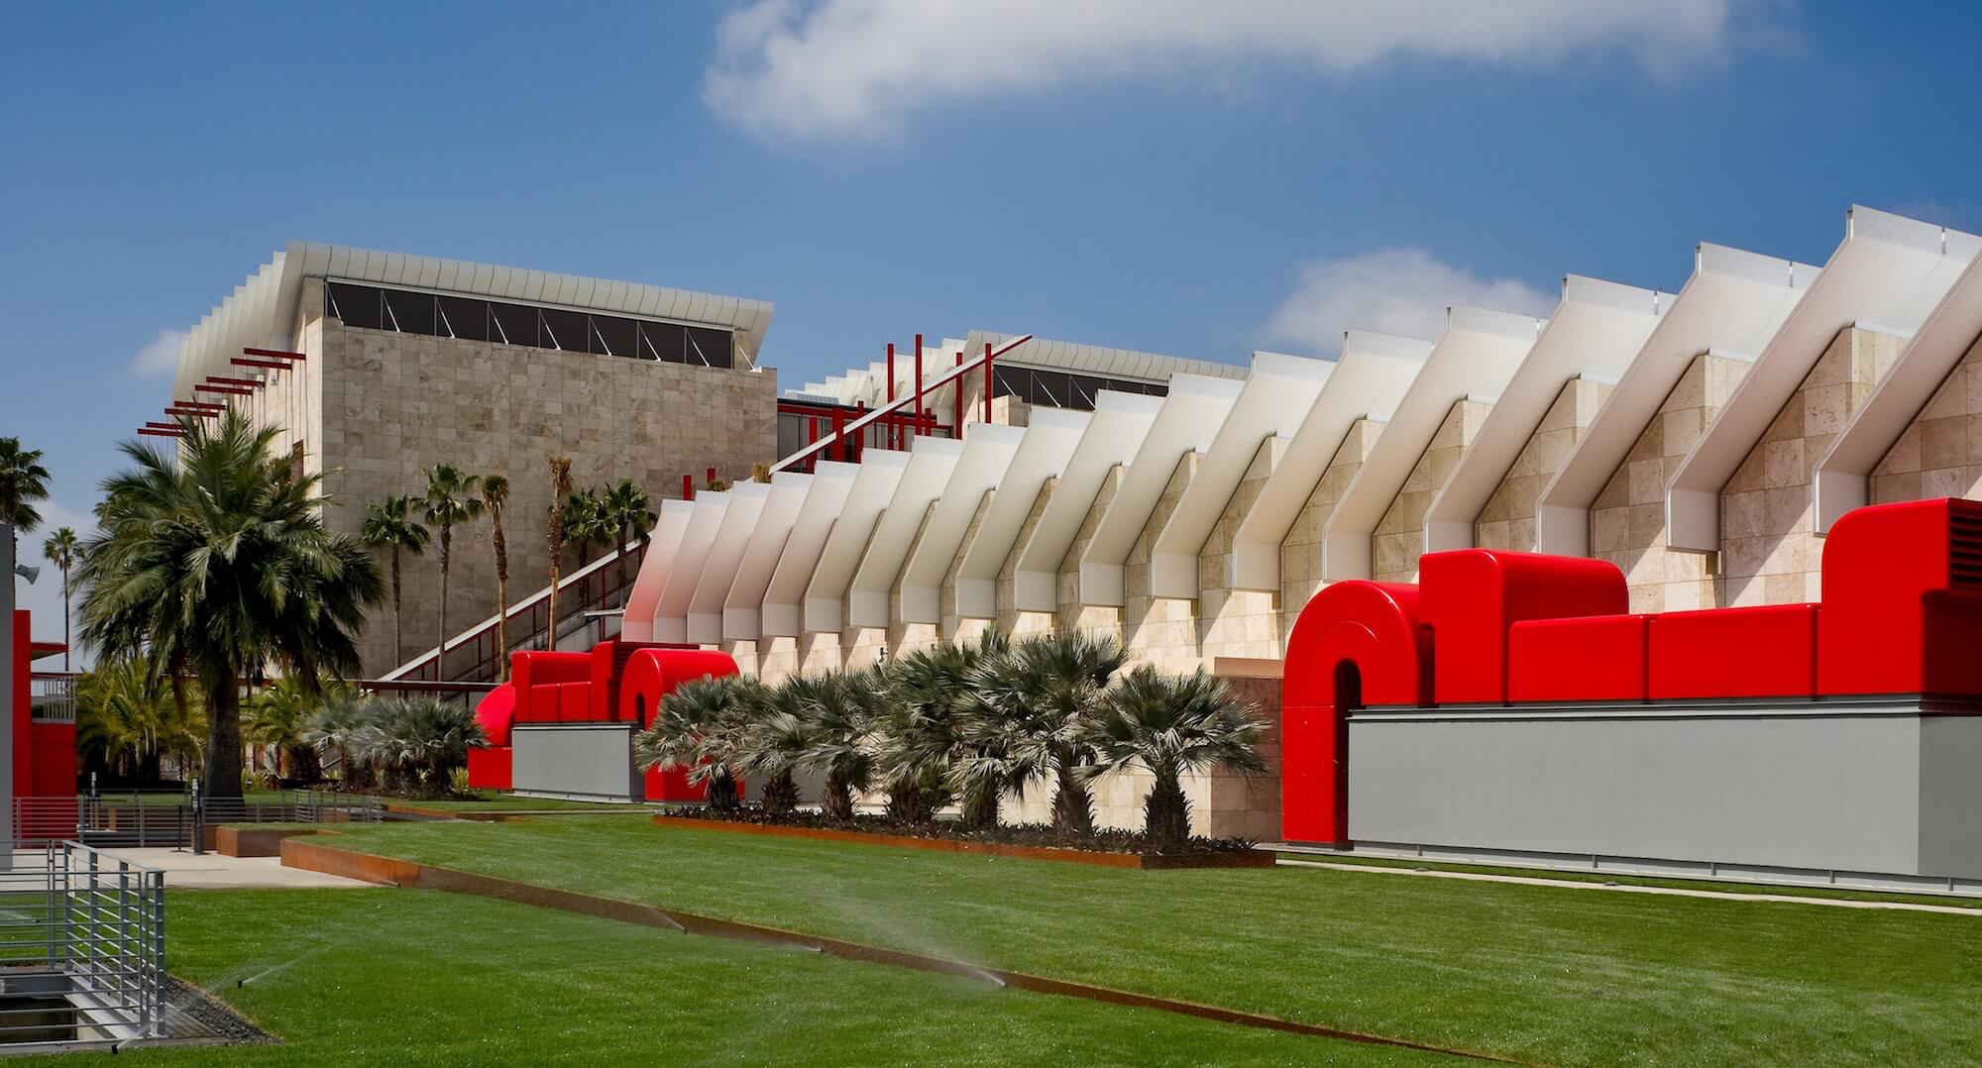
Research Goals & Methodology
LACMA
Notes:
DS

Slide 4
Research Goals
LACMA
How might we streamline LACMA’s ticketing experience for users?
Derive insights on purchase trends from Tessitura
Uncover patterns in user behavior
Understand audience journey and pain points
Notes:
DS

Slide 5

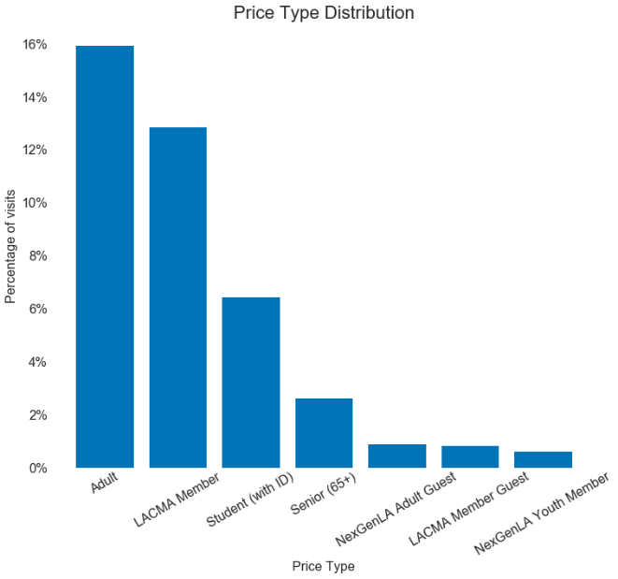
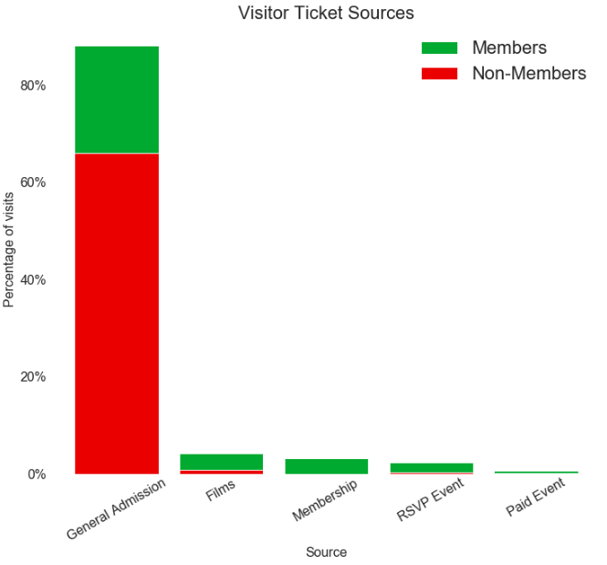
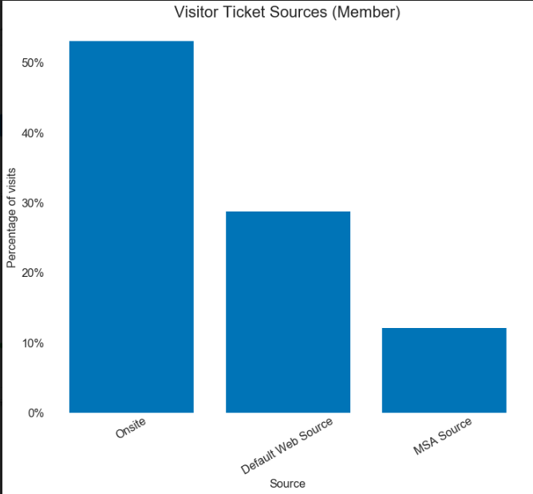
Approach Step 1: EDA
LACMA
Price Type
Members vs. Guests
Ticket Sources
Notes:
DS

Slide 6

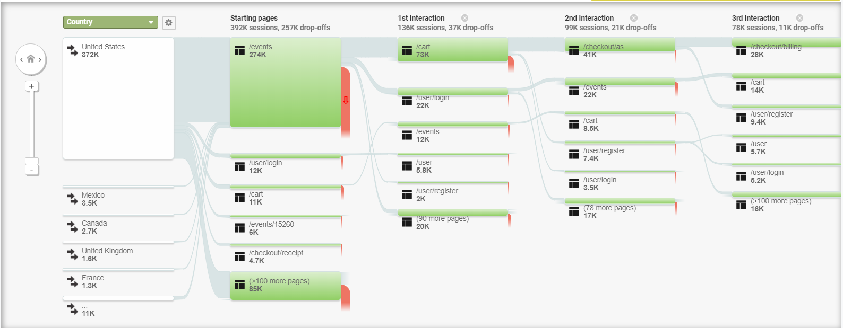
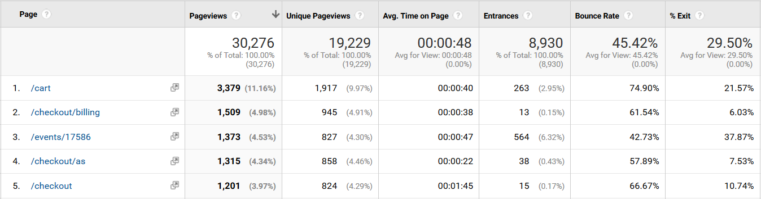
Approach Step 2: Google Analytics
LACMA
User Flows
Behavioral KPIs
Notes:
DS

Slide 7
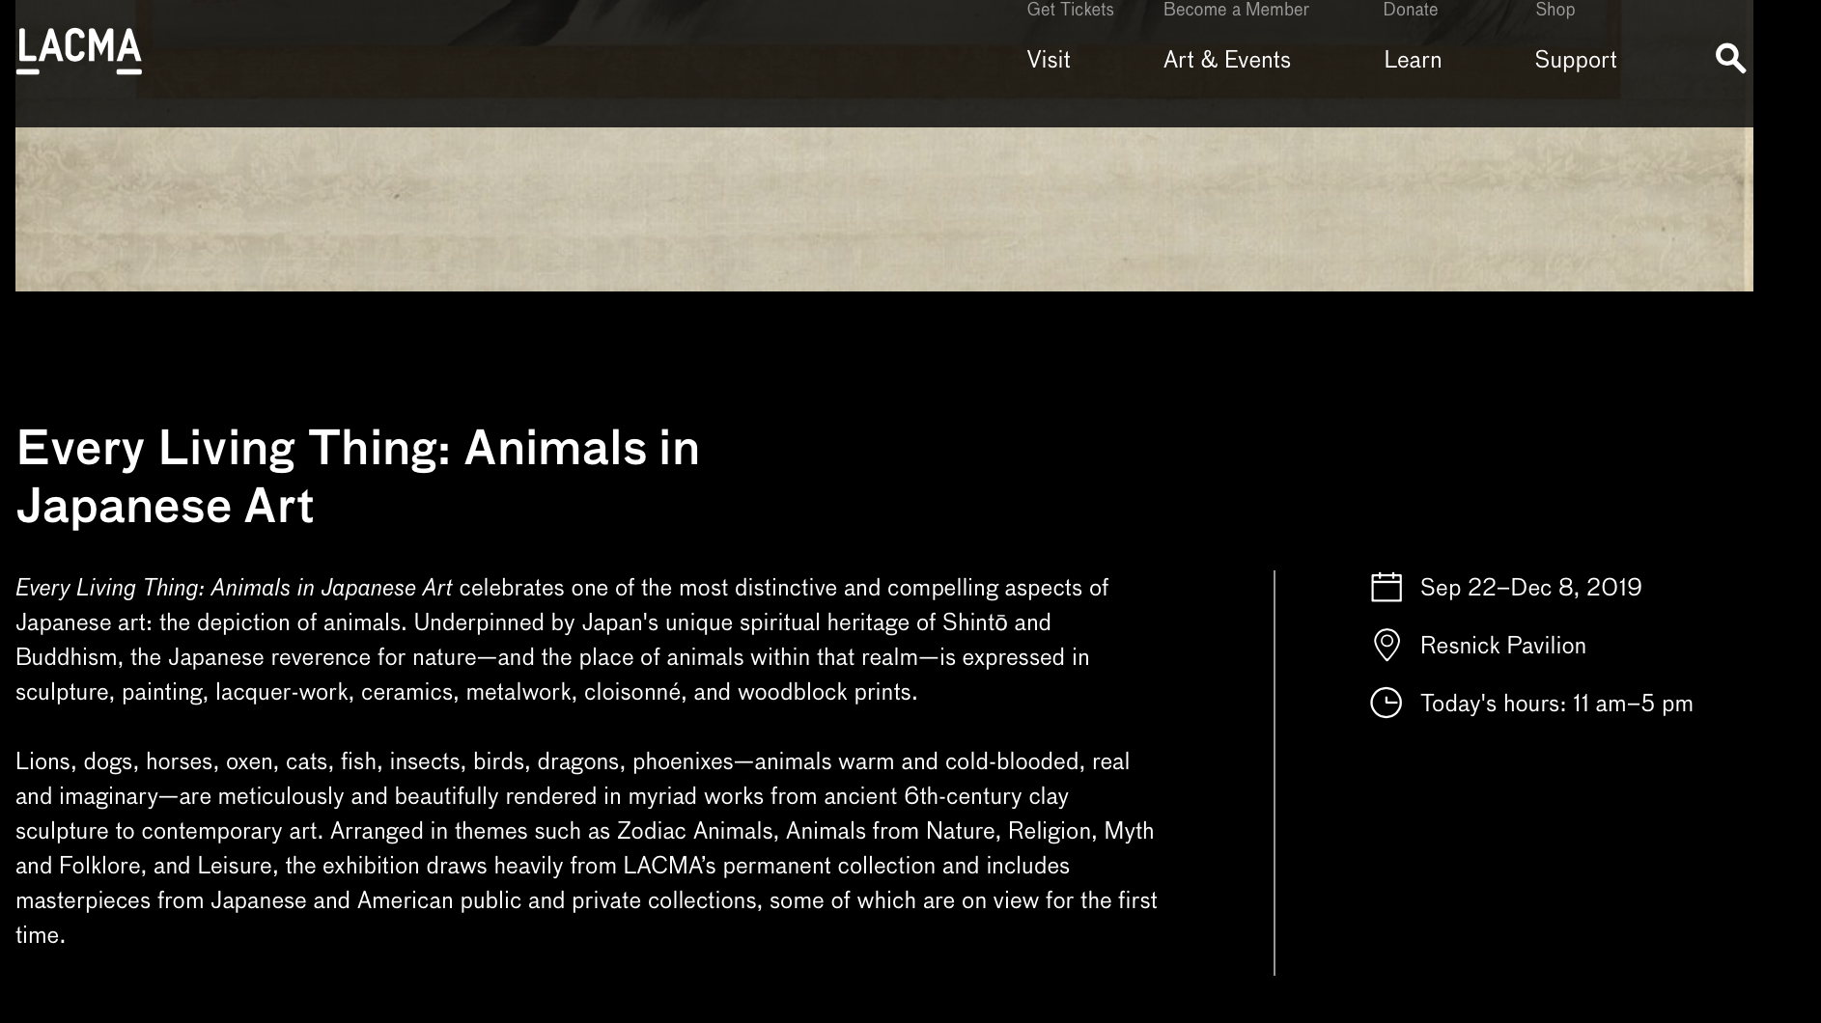
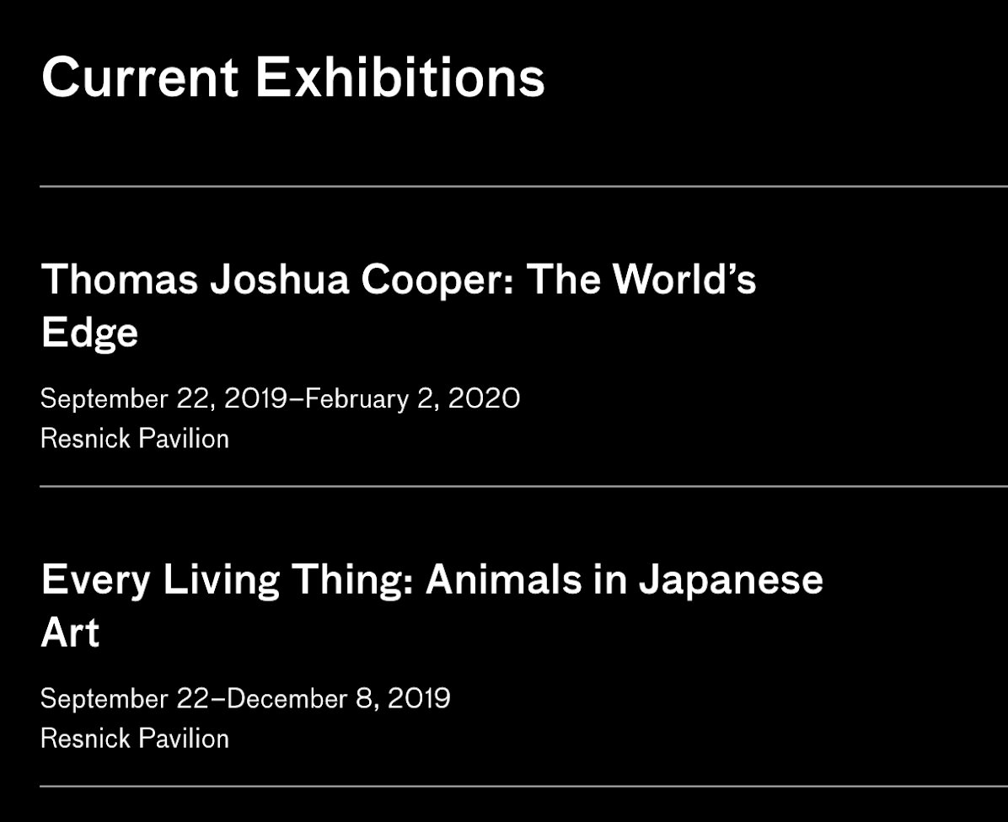
Approach Step 3: User Journey
LACMA
Interact with ticketing site and identify pain points from different user perspectives
Notes:
DS

Slide 8
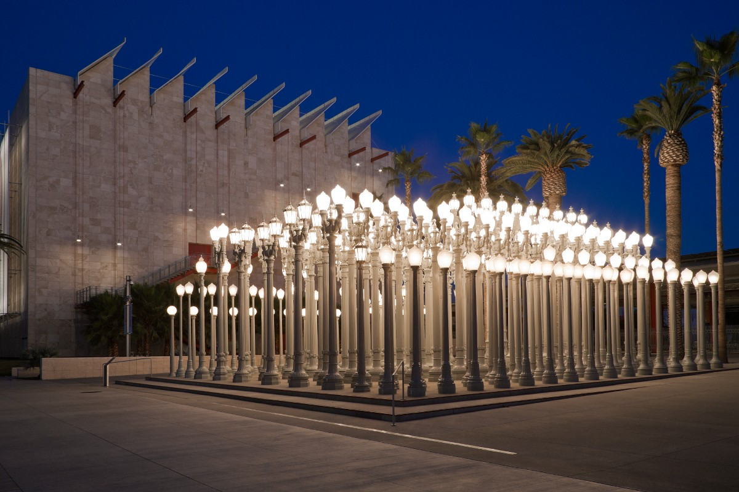
Data Analysis & User Journey
LACMA
Notes:
SR

Slide 9
Steady user flows from starting pages
33% through traffic from starting pages flowing into cart
LACMA
Notes:
SR

Slide 10
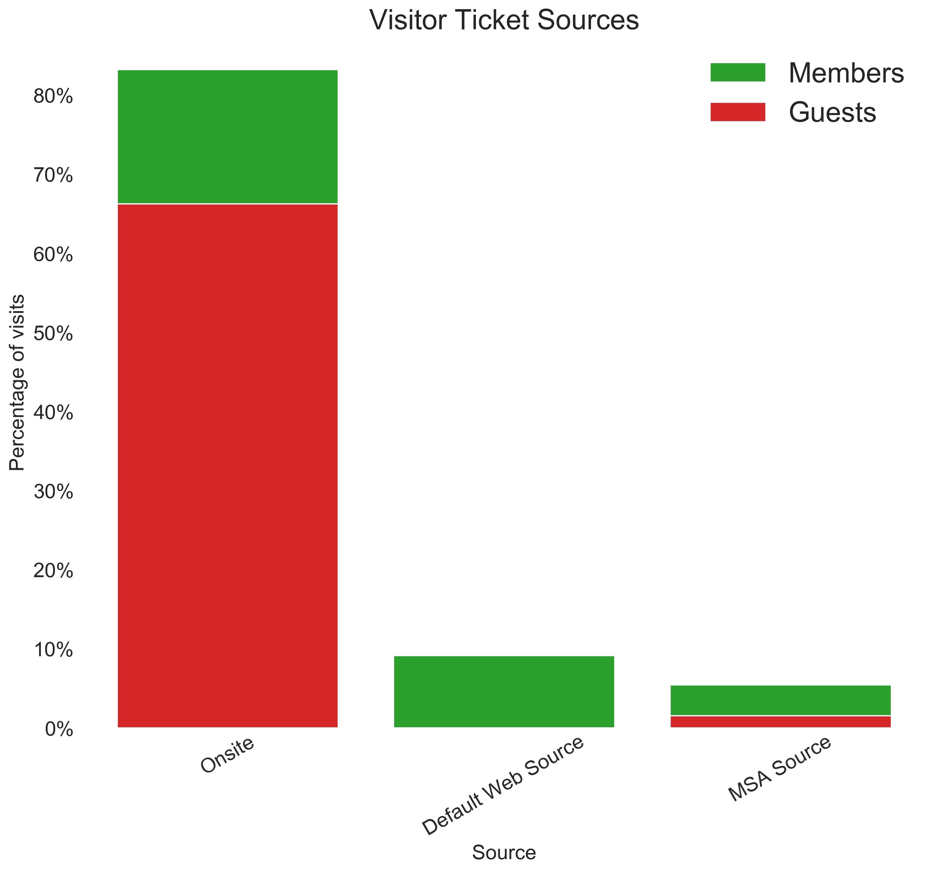
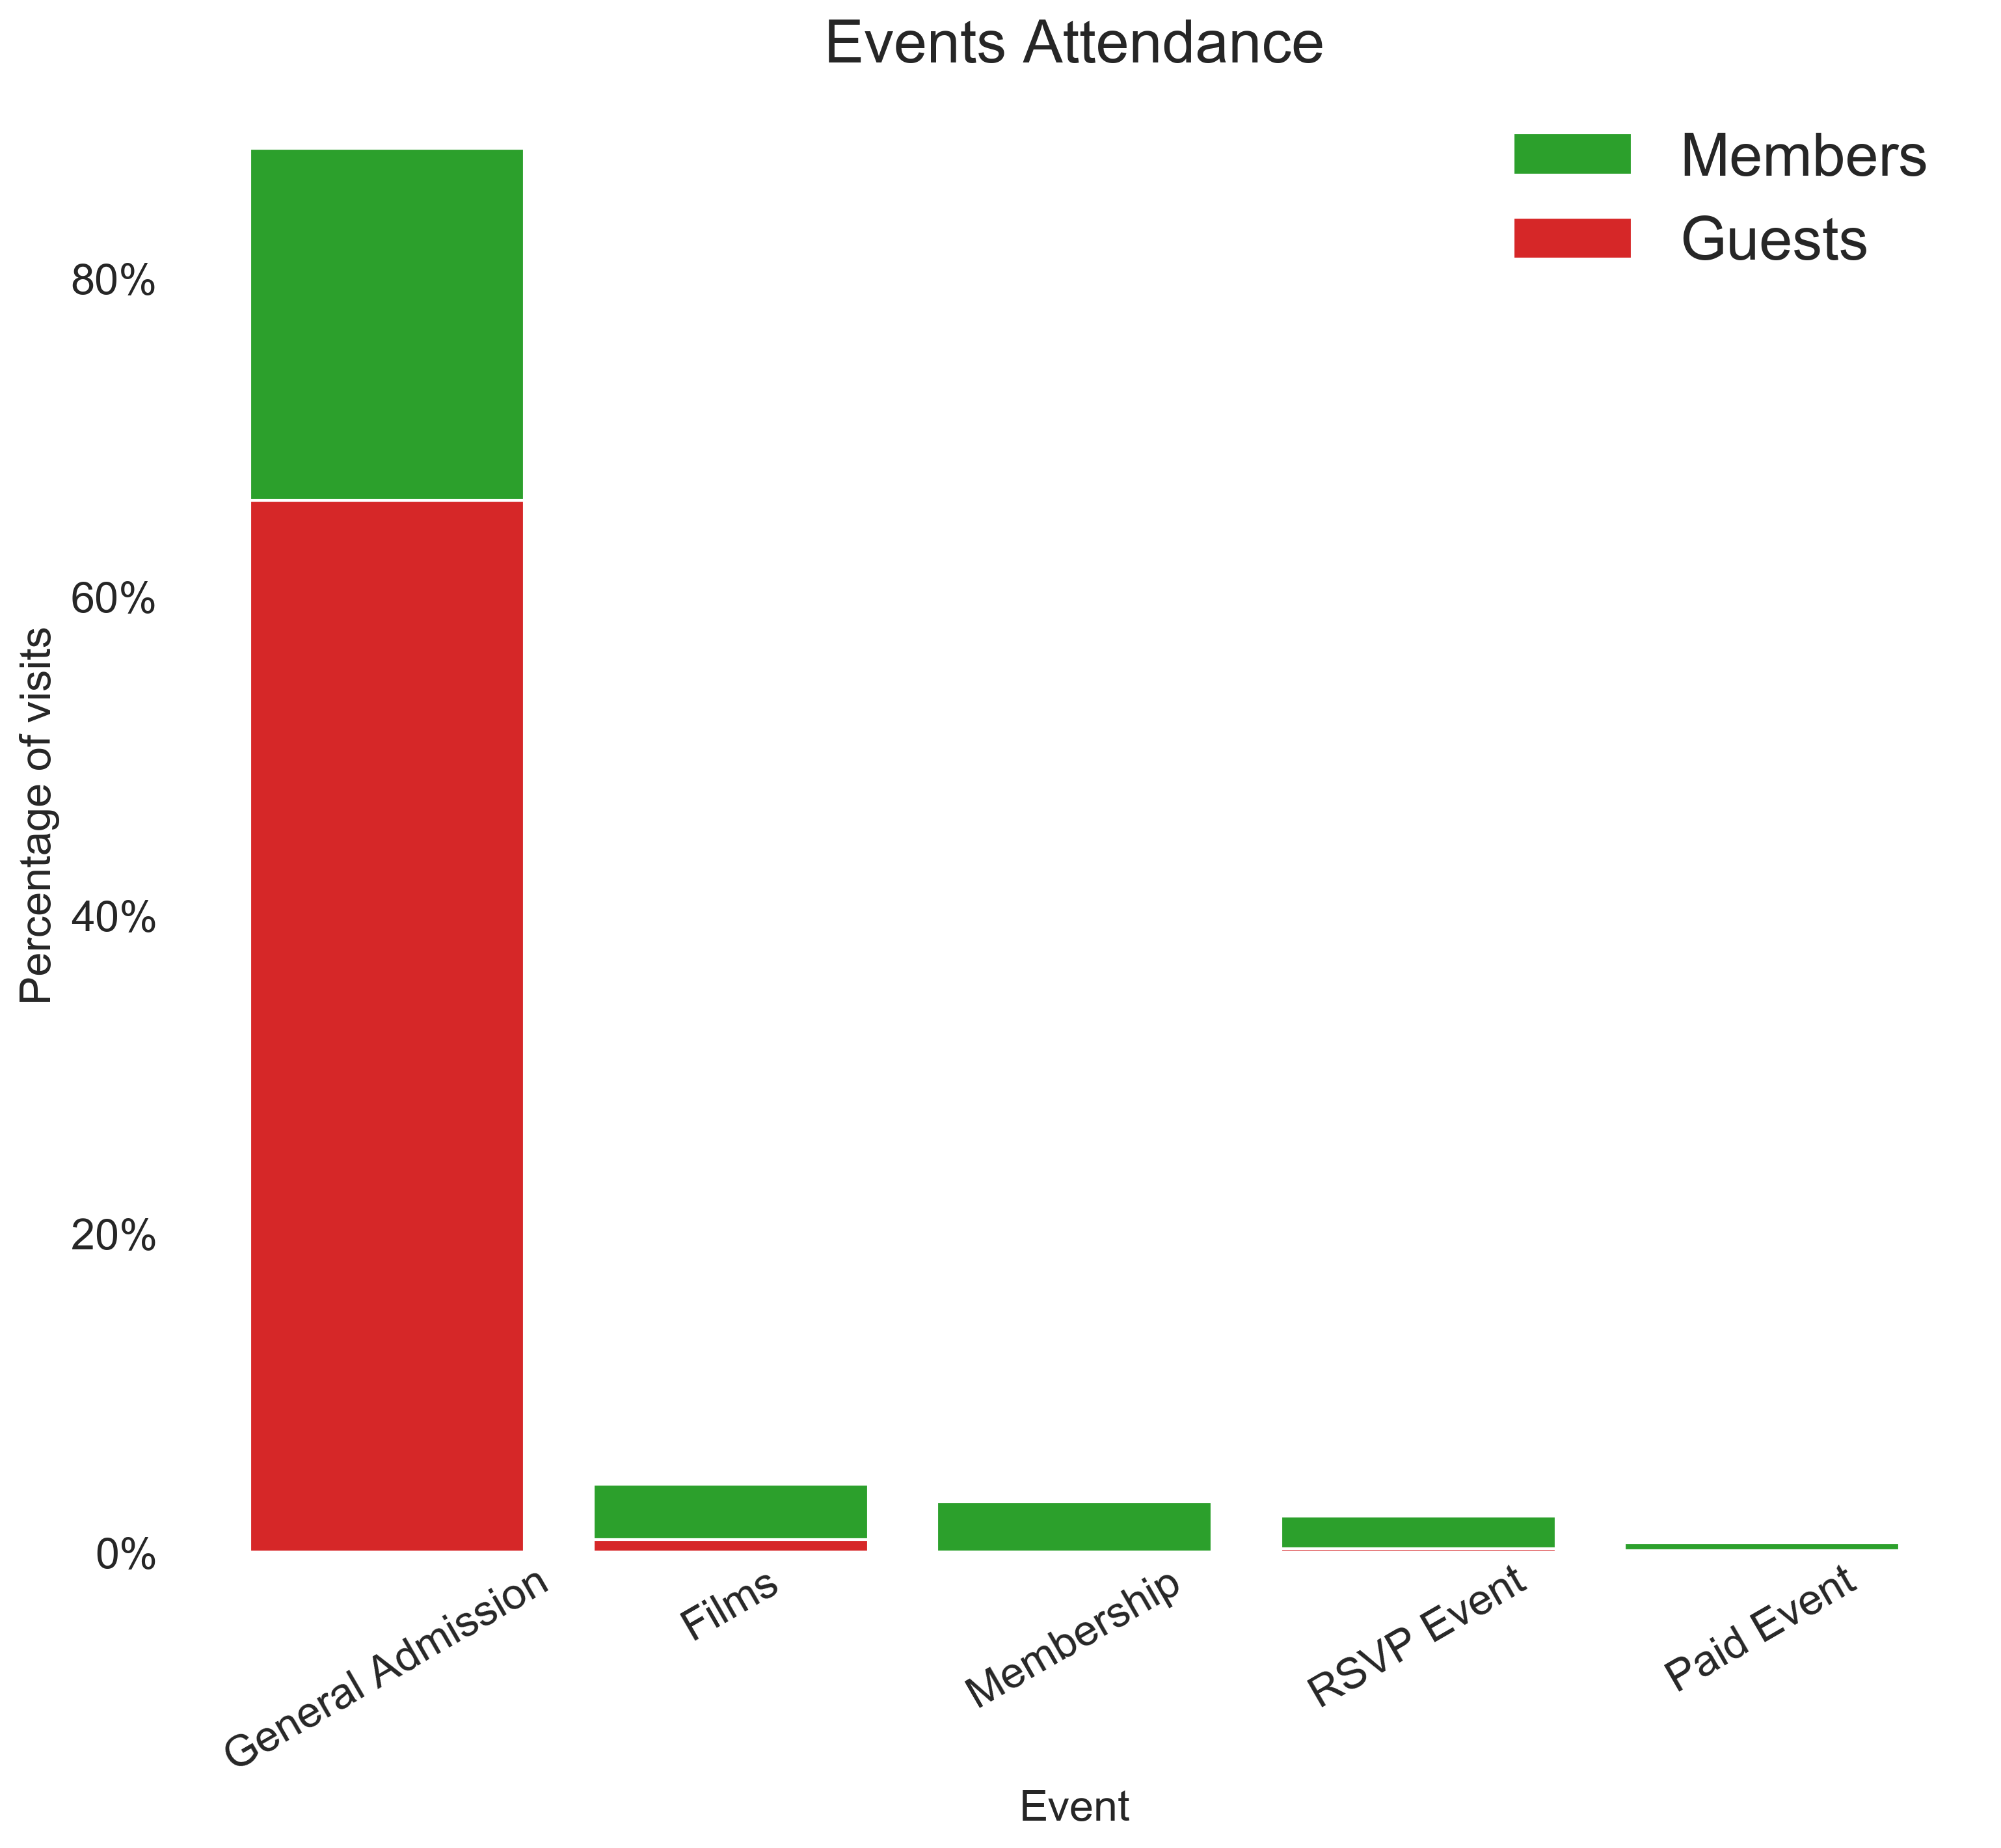
Analyzing Ticketing Data
LACMA
Majority of purchases onsite
Majority of purchases General Admission
Notes:
SR

Slide 11





Key Findings
Steady through traffic per User Flows
Onsite, general admission tickets driving volumes
Members attend
broader range of events
LACMA
Notes:
SR

Slide 12

User Journey
User’s first interaction begins as the ‘Arts & Events’ tab to browse through interesting exhibitions
LACMA
Notes:
VC

Slide 13
User Journey (cont.)
User identifies exhibition and clicks to learn more...
LACMA
3
2
1
Notes:
VC

Slide 14
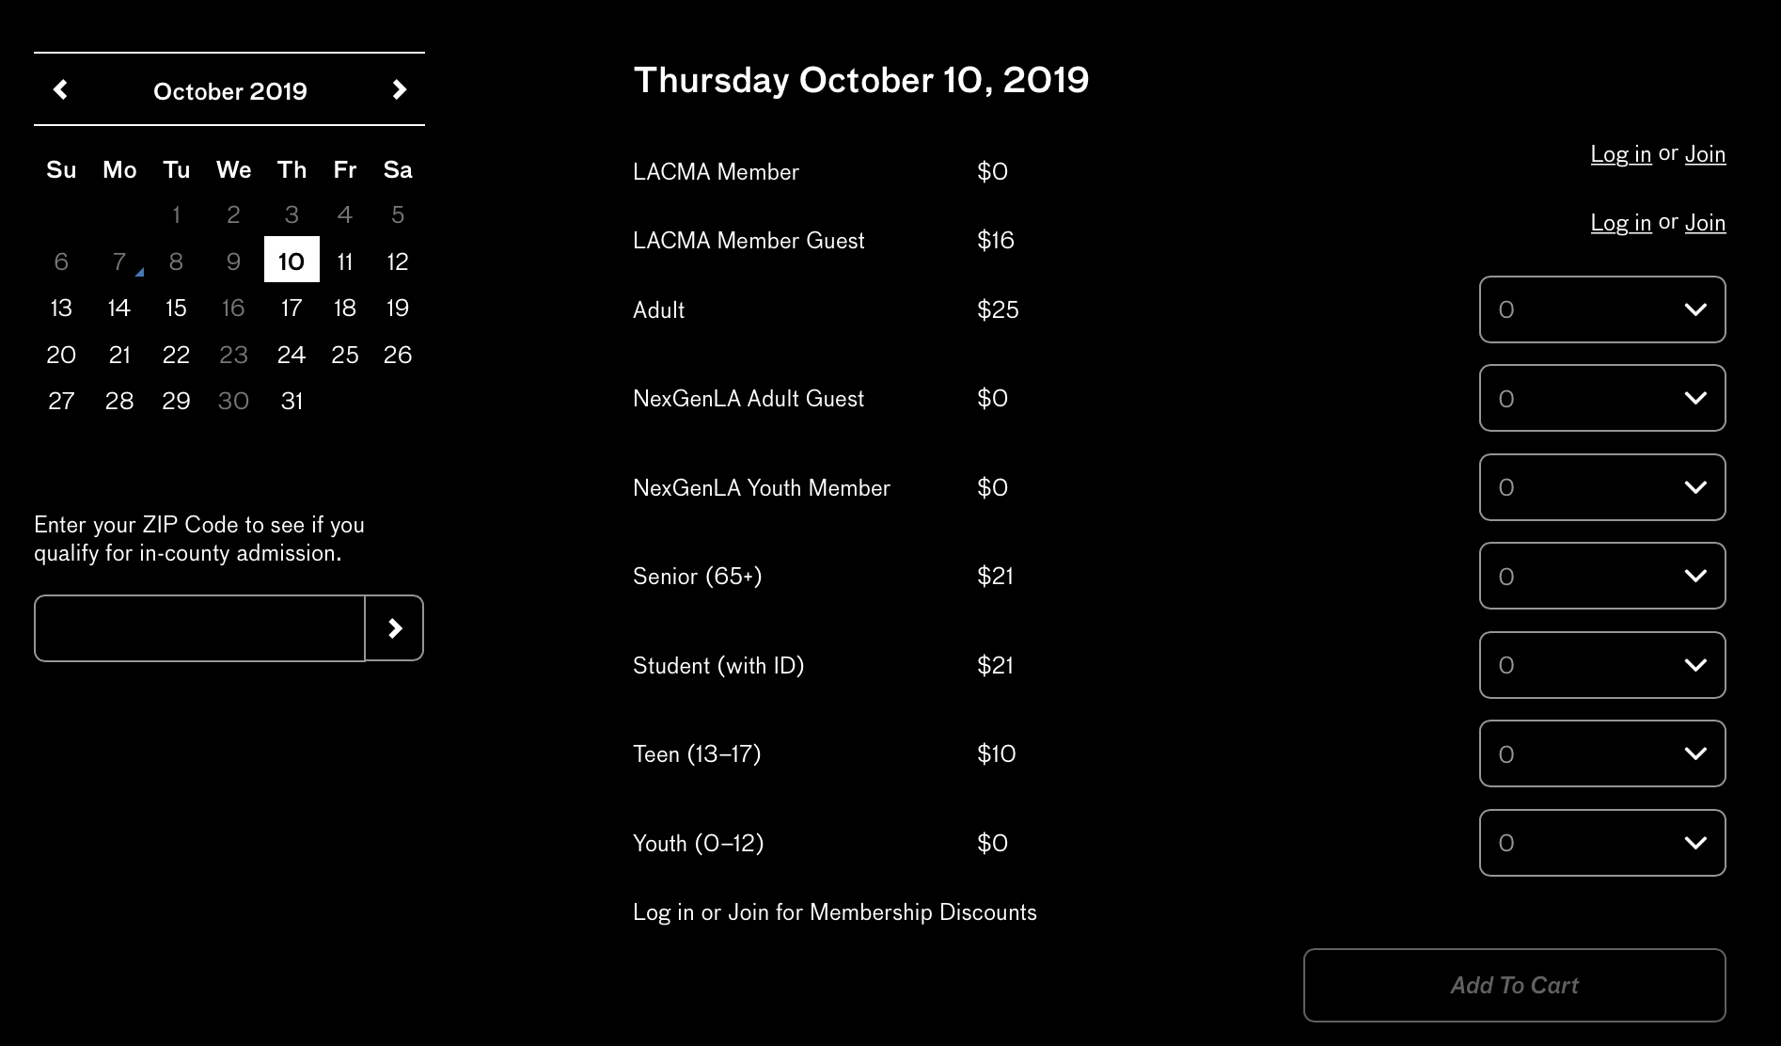
User Journey (cont.)
User selects date and proceeds to General Admissions ticketing options
LACMA
Notes:
VC

Slide 15
User Journey (cont.)
Is this the most the can get out of my ticketing experience?
What if I am interested in specific events?
What other events can I attend?
LACMA
Notes:
VG

Slide 16
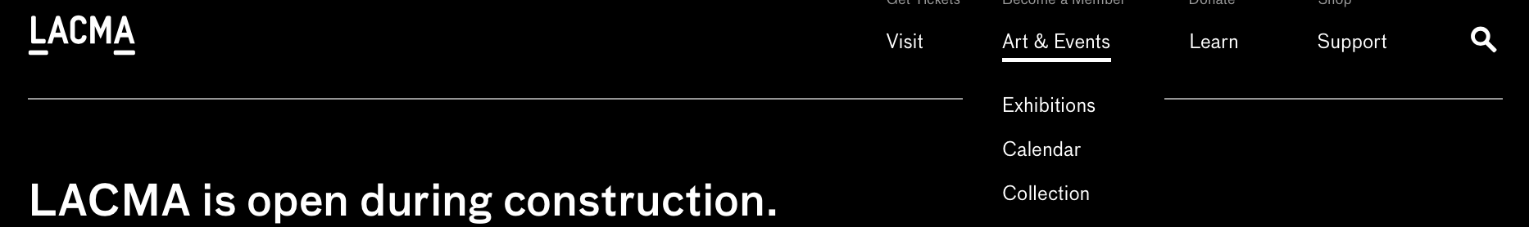
User Journey (cont.)
User searches on calendar...
LACMA
Notes:
VG

Slide 17
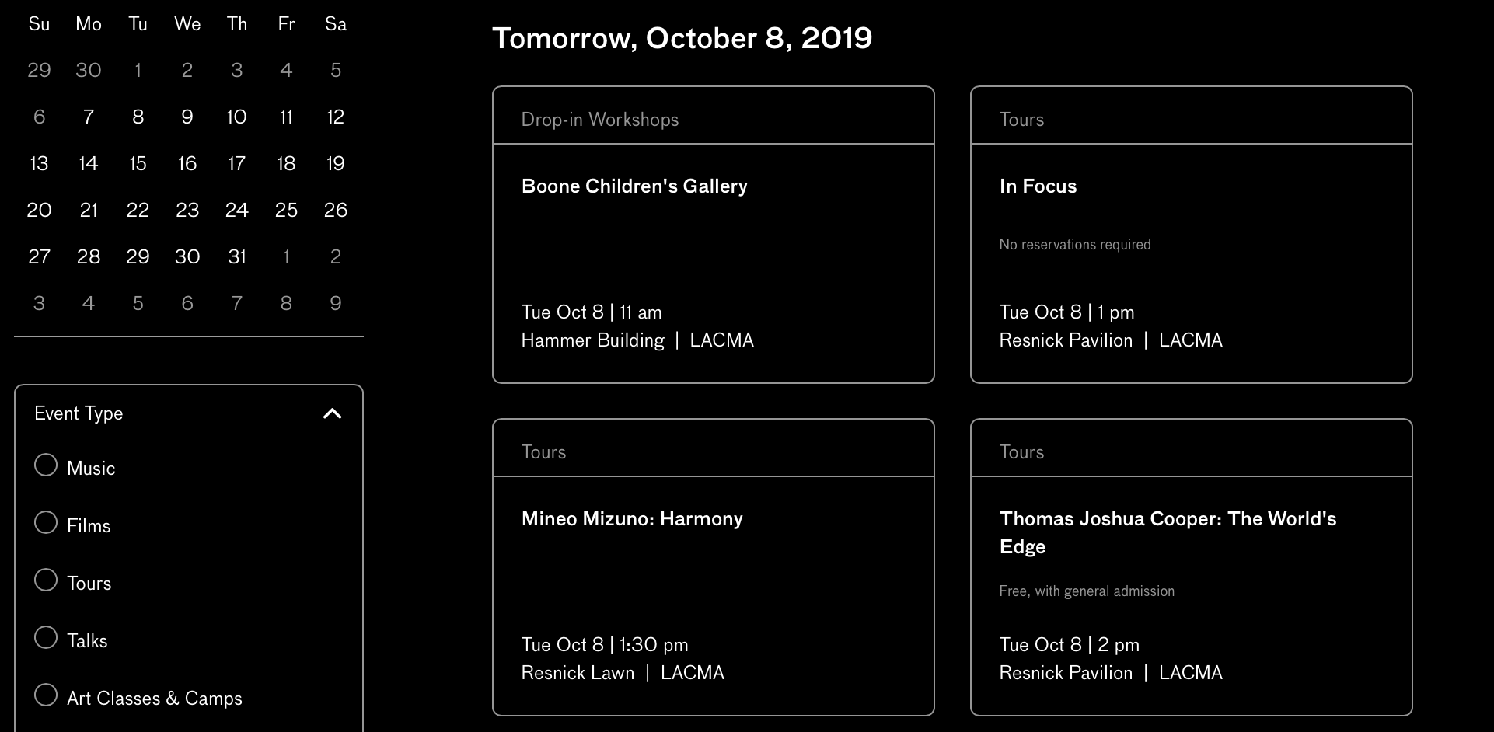
User Journey (cont.)
...to find types of events available
LACMA
Notes:
VG

Slide 18




Pain Points
LACMA
Events versus
General Admission
is unclear
Event types are challenging to find
/ seem hidden
Multi-process user
journey to access
tickets via events
Notes:
VC

Slide 19
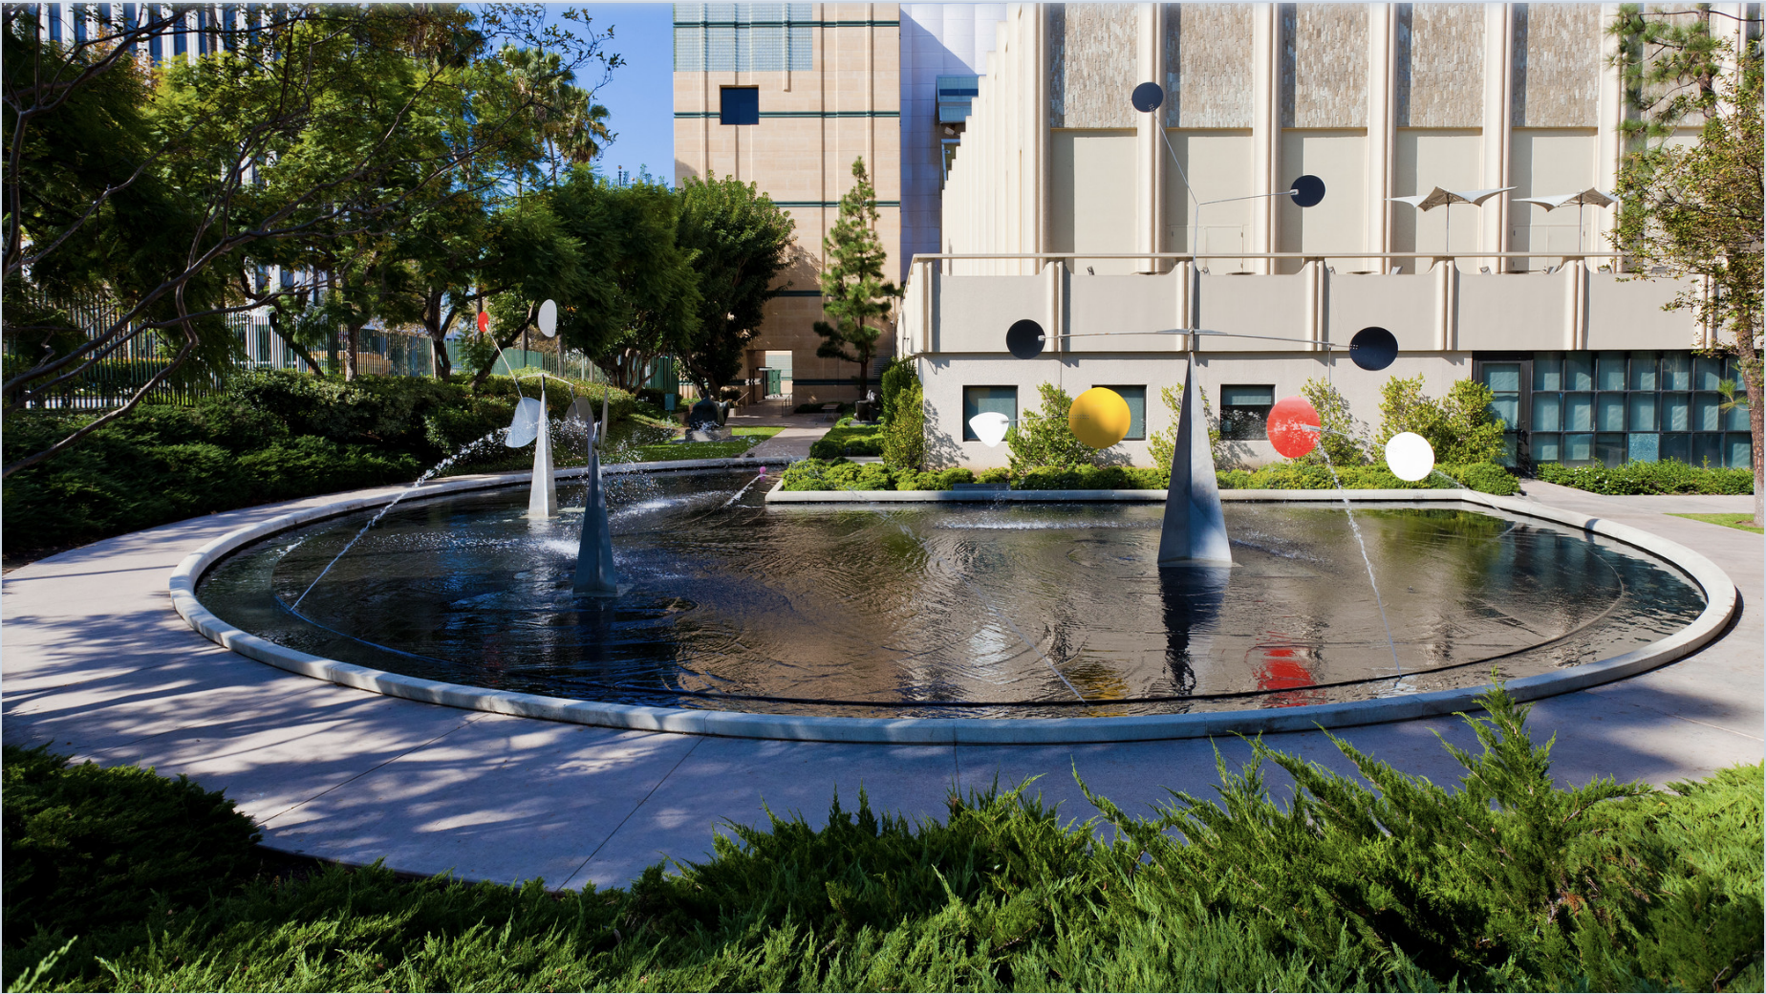
Recommendations
LACMA

Slide 20

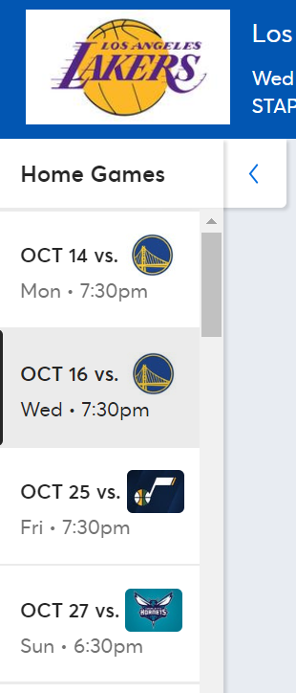
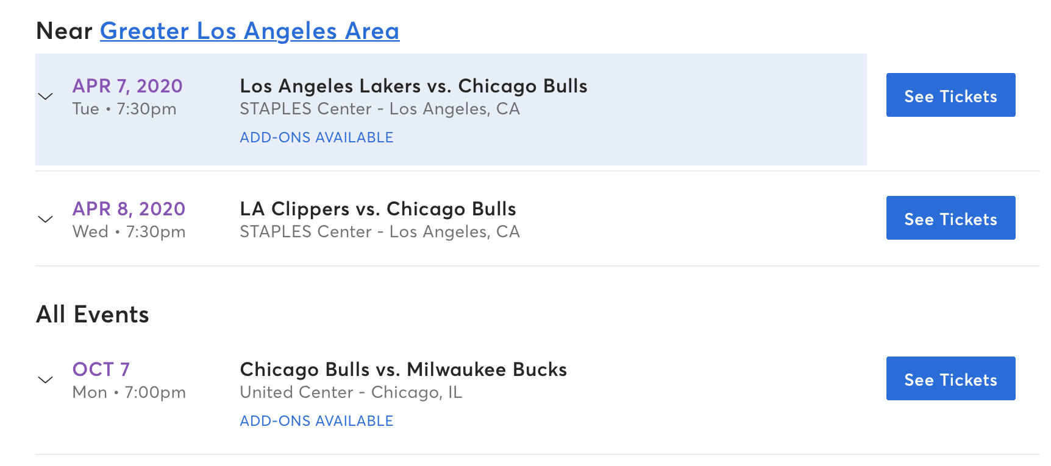
Drawing Insights from Competitors
LACMA
Clear Call to Action (CTA)…
… and other events publicized
Notes:
RG

Slide 21

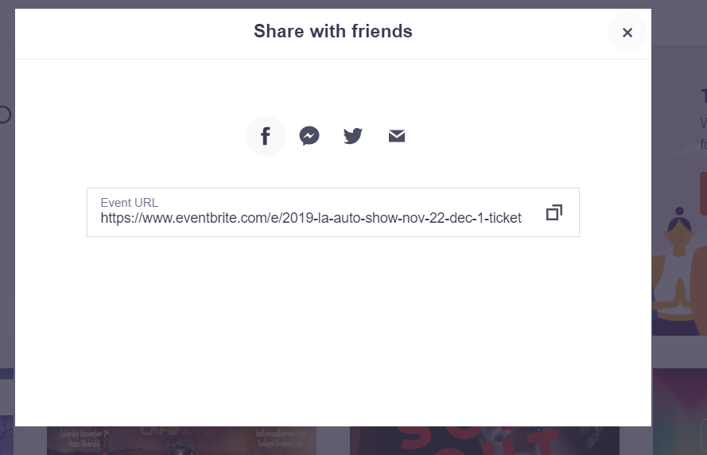
Drawing Insights from Competitors (cont.)
LACMA
Refer a friend
Notes:
RG

Slide 22


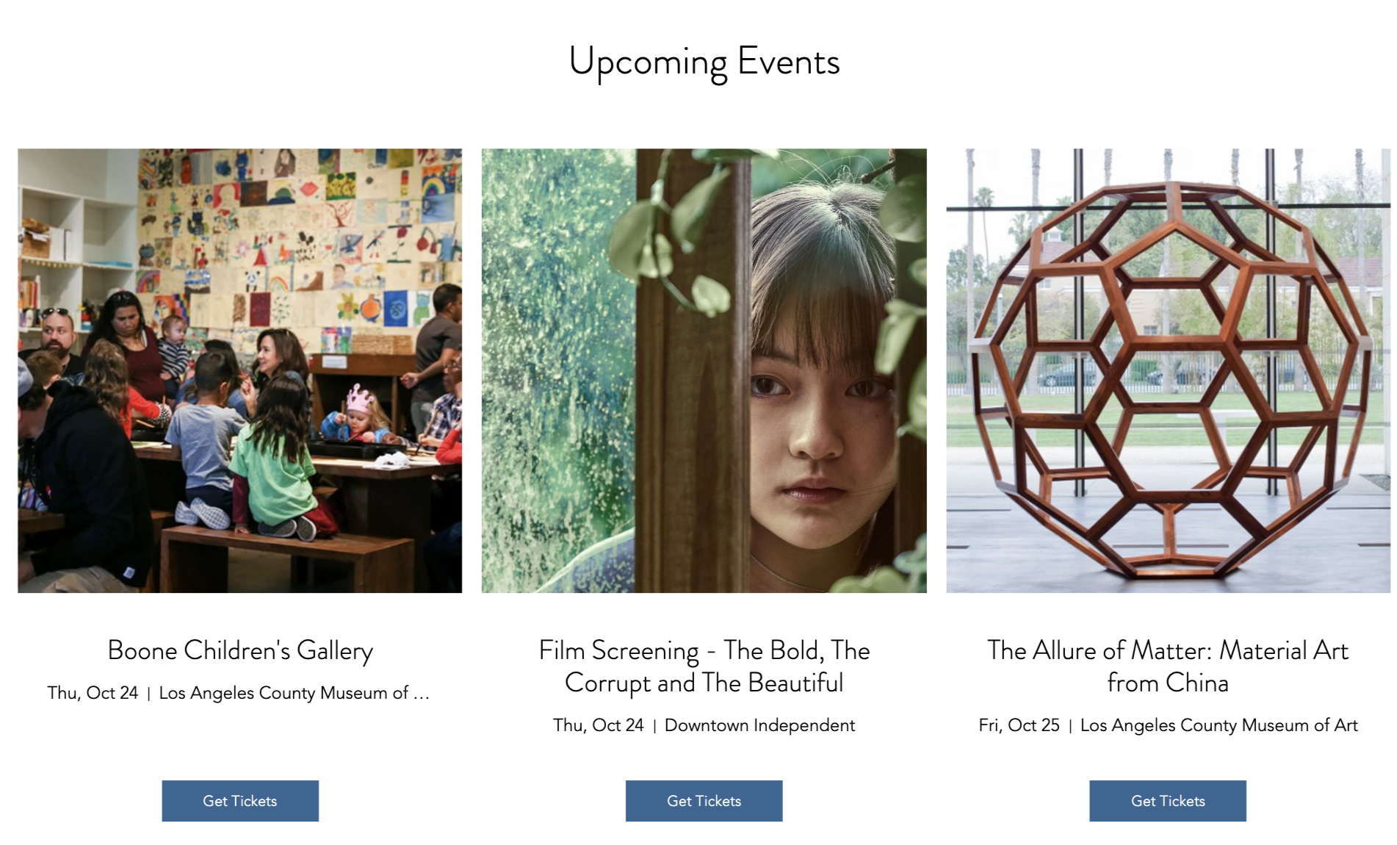
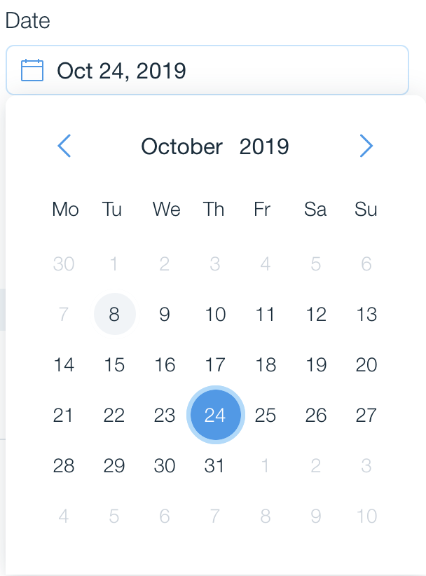
LACMA
Our Recommendations
Check out more events
Notes:
DK

Slide 23

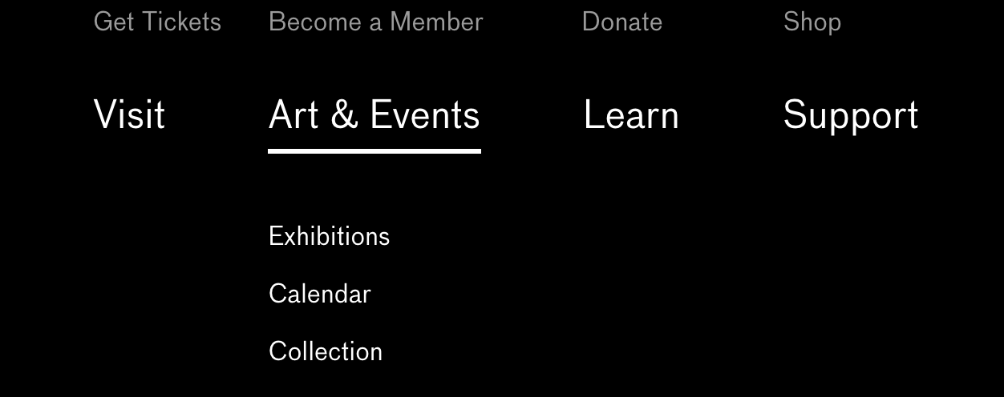
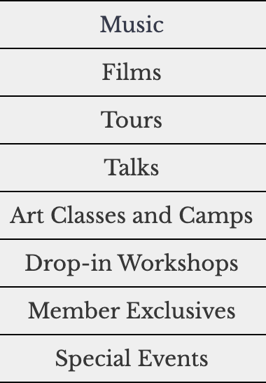
Our Recommendations (cont.)
Current Layout
Suggested Layout
LACMA
Notes:
DK

Slide 24






Desired Outcomes & Measurement
LACMA
Objectives
Action
KPIs
Targets
Task Completion Rate
Increase
Conversions
Increase Online Ticket Sales
Events publicity at forefront of the ticketing experience
Number of Sessions
Time since last Visit
Increase Diversification of
Events Attended
Increase
Web Traffic
New vs.
Recurring Users
Streamlined and intuitive user journey
Increase Membership Conversions
Long-Term
Customer
Engagement
Time on
Site
Notes:
RG

Slide 25
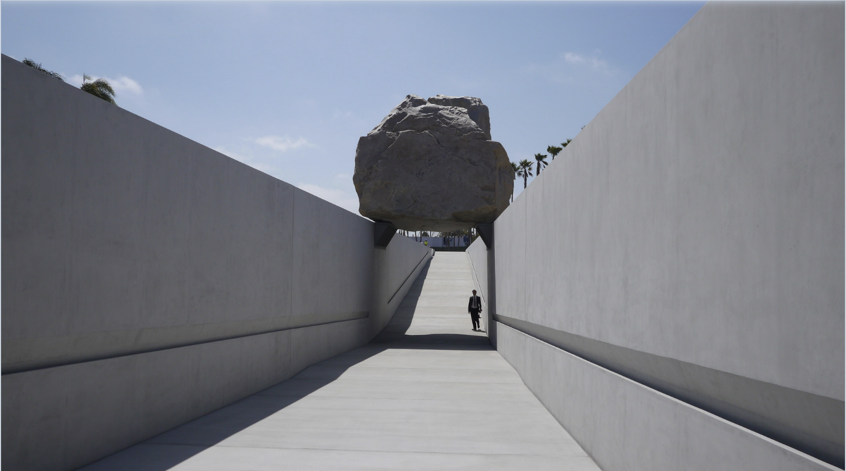
Further Evaluation
LACMA
Notes:
RG

Slide 26
LACMA
High Cart and Checkout Abandonment Rate
Notes:
AR

Slide 27

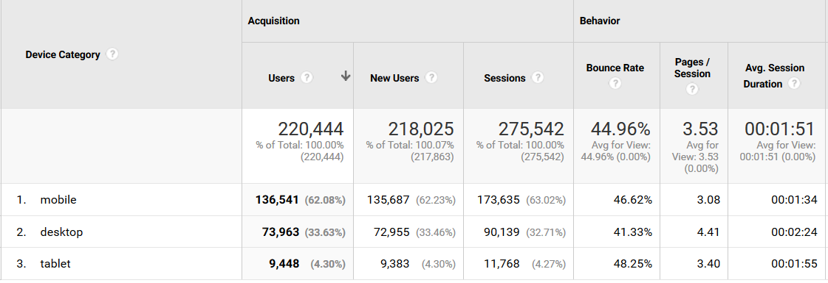
LACMA
Device Users
60% of the users are browsing through mobile
Notes:
AR

Slide 28


Going forward…
Task completion rate survey
Site testing by select few users through 3rd party
Optimize browsing on mobile
LACMA
Notes:
AR

Slide 29
Thank You for Listening!
Notes: plot titles need to be changed
Nomenclature change from “Non-member” to “Guest”
LACMA
Notes:
DS

Slide 30
Roles
Divya Sripathy | Project Manager, Research Strategy and Presentation Flow
Vishal Chollera | Project Manager, Storyboarding, Presentation Content
Dhwani Kapadia | Storyboarding and Presentation
Shashank Ravi Shankar | Exploratory Data Analysis and Presentation
Rajat Gaur | Exploratory Data Analysis, Storyboarding, Presentation
Varun Gupta | Exploratory Data Analysis, Presentation
Akash Rawat | Google Analytics, Presentation
LACMA
Notes:
DS

